Slide 1

EduBridge
“COFFEE SHOP WEBSITE USING HTML,CSS,JAVASCRIPT”
Group Members
BONDRE AMRUTA
in the guidance of
Ms. Amruta Deore

Slide 2
INDEX
Introduction
Resources Required
Project Description
Screenshot
Conclusion
References

Slide 3
INTRODUCTION
Coffee Shop website in based on three Technologies HTML,CSS and JavaScript.
HTML is used to Page designed Layout.
Adding the styles to the pages I have used CSS(Cascading Style Sheet).
JavaScript is used to create interactive website.
The coffee shop webside is done using HTML,CSS and javaScript TECHLOGY.

Slide 4
RESOURCES REQUIRED
SOFTWARE REQUIREMENT
Operating System : Windows10
Software : Notepad++ and any browser
HARDWARE REQUIREMENT
Ram : 4.00GB
Processor : Intel core i3
Hard Disk : Minimum 10 GB

Slide 5
PROJECT DESCRIPTION
The Coffee shop Website is based on front end Technologies HTML,CSS, and javaScript.
this project is used to any time contact to the coffee shop.
The main aim to create this project Save the time.
This Project is Useful to User and Customer.
In this project display the all things related to coffee shop with google map.

Slide 6
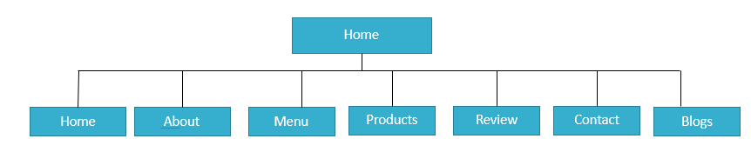
Flow chart

Slide 7
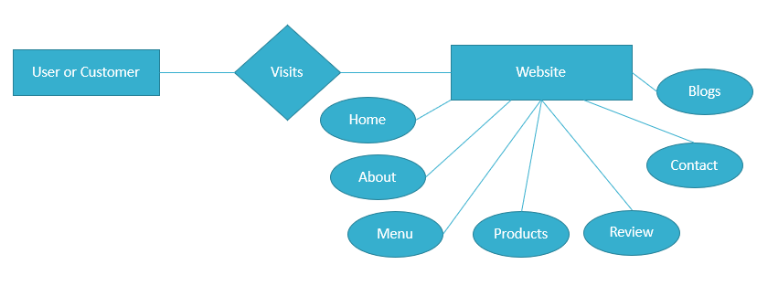
ER-Diagram

Slide 8
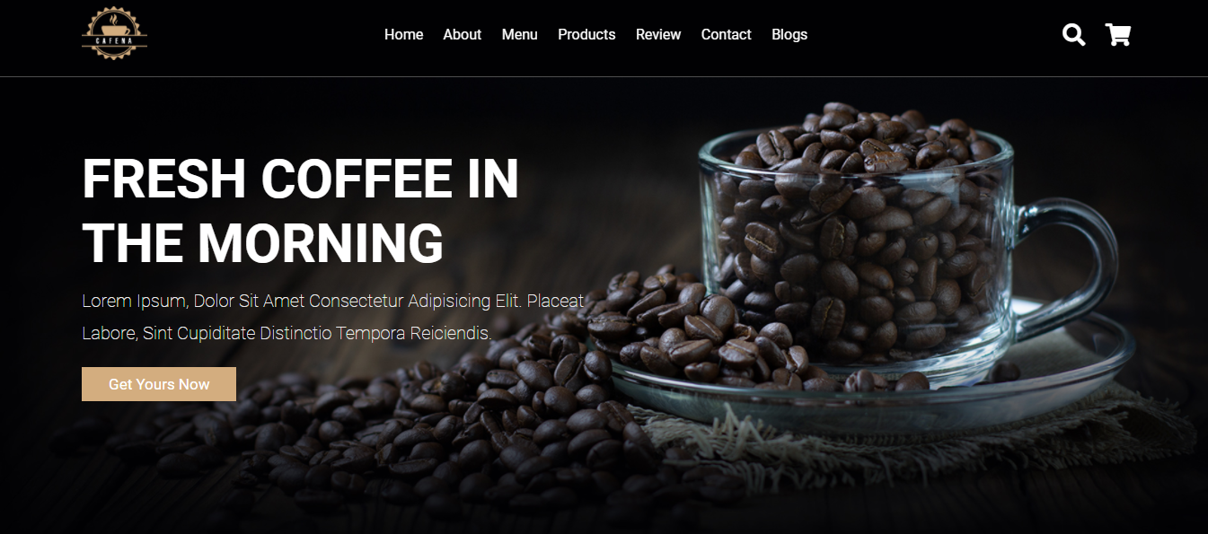
SCREENSHOT
HOME PAGE

Slide 9
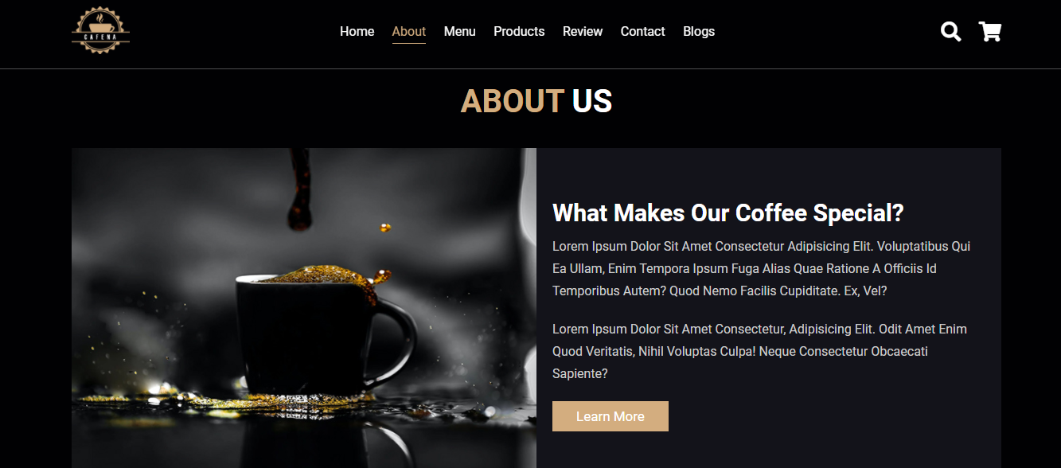
ABOUT US

Slide 10
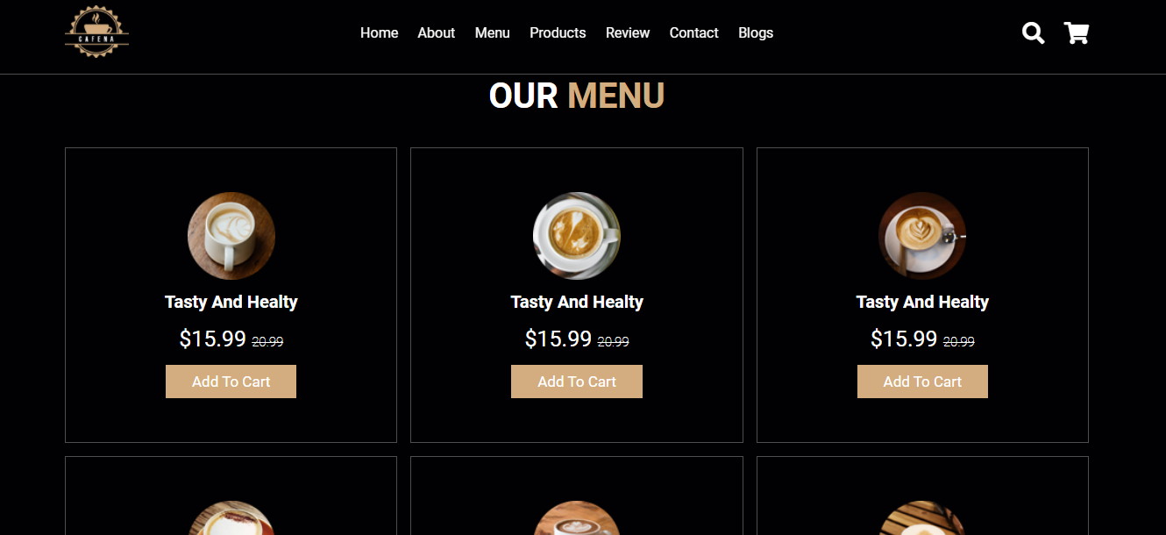
OUR MENU

Slide 11
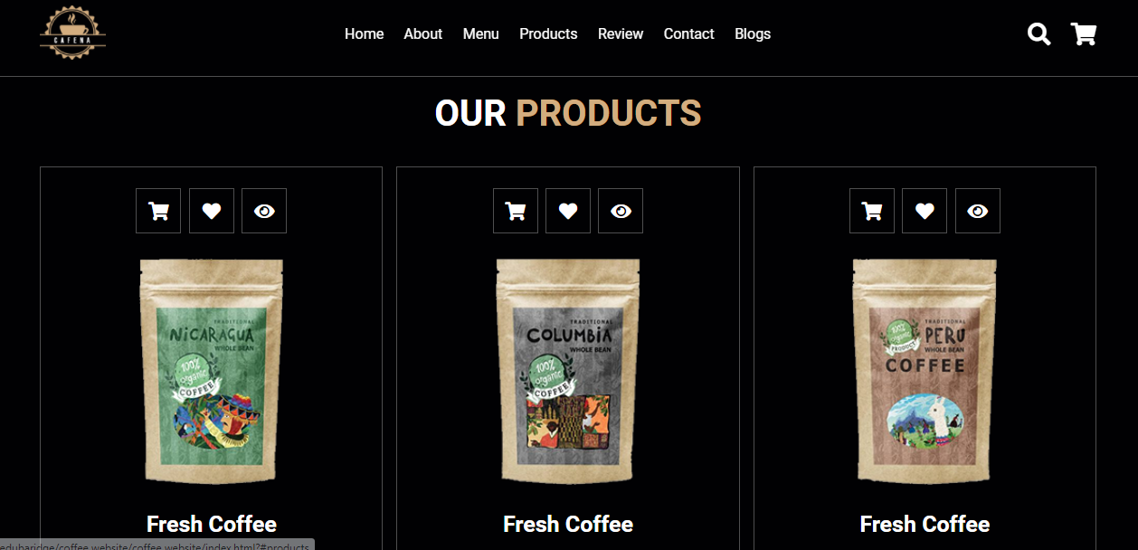
PRODUCTS

Slide 12
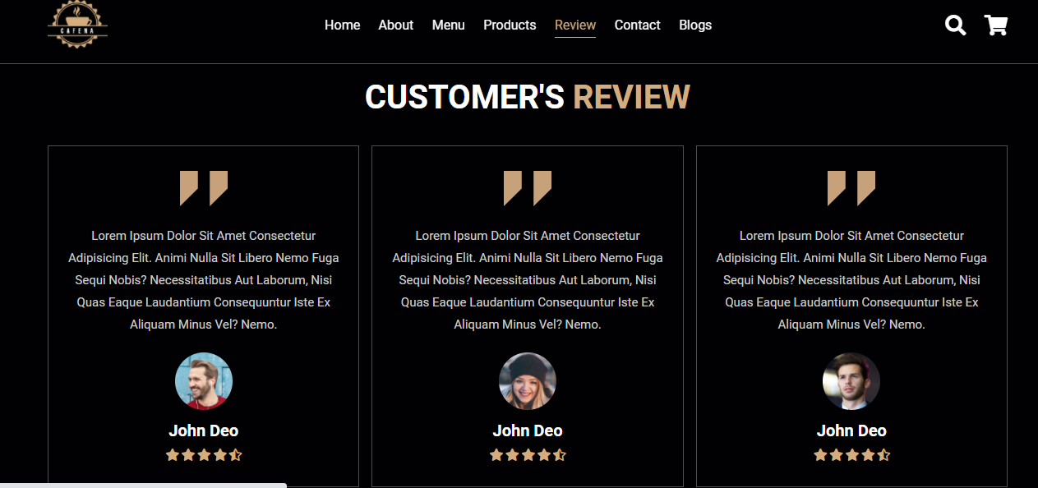
REVIEW

Slide 13
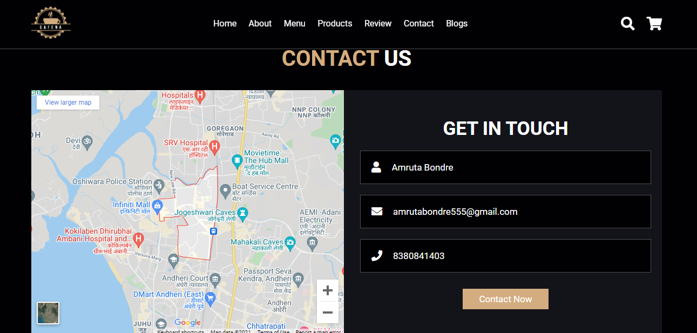
CONTACT US

Slide 14
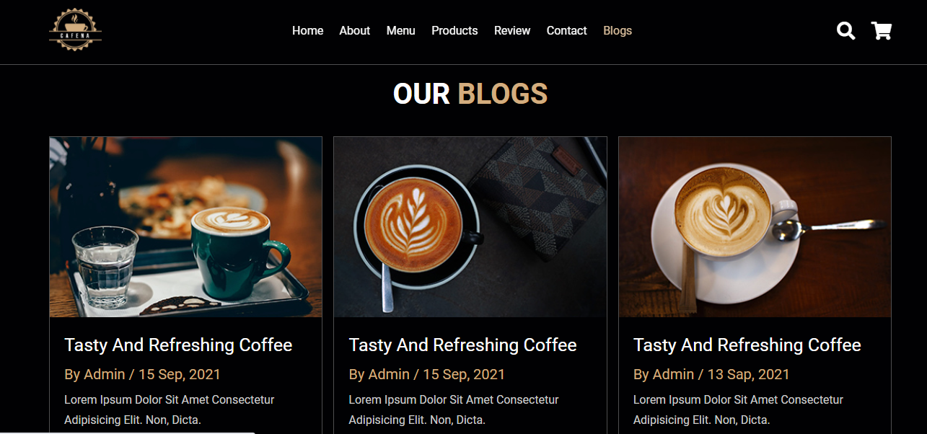
BLOGS

Slide 15


Slide 16
REFERENCES
www.edubridgeindia.com

Slide 17
CONCLUSION
The coffee shop website is an online website which provides the facility to the user and customer is anywhere and anytime . user can show the coffee shop related detail easily.

Slide 18

THANK YOU!!!

